Slide 1
Recommendation of Alternative Restaurants
Capstone Project - The Battle of Neighborhoods

Slide 2
Use case
Nowadays it is very common for people to research for a restaurant online before a meal and/or make reservation. What if the restaurant has no table when you visit or make reservation? You start the search all over again. The goal of this project is to provide an algorithm to recommend an alternate restaurants that are the "closest" to your first choice.

Slide 3
Business Problem
The audience of this project can be any website or application that suggests restaurants. (e.g. Opentable, Yelps etc) The following can be the use cases of the algorithm:
Booking is not available when the user trys to make a reservation online
No table is available when the user visits and the user wants to look for an alternative restaurant A naive approach is to just list all the restaurants nearby sorted by the distance. However it can do better by recommending one that is the "closest" to the original one, in terms of location, type of cuisine and pricing etc. The smarter the recommendations are the more pleasant the experience will be for the user of the website or application.

Slide 4
Data
The source of data will be FourSquare
Features will include name, location, category, pricing and how busy a restaurant is
APIs used are: https://api.foursquare.com/v2/venues/explore https://api.foursquare.com/v2/venues/{venue_id}

Slide 5
Methdology
Clustering will be done for the restaurants in the area. The most similar ones will be in the same cluster.

Slide 6
Machine Learning
K-means clustering is used because:
It is Easy to implement
With a large number of variables, K-Means may be computationally faster than hierarchical clustering (if K is small).
K-Means may produce higher clusters than hierarchical clustering
Pandas get_dummies was used to do the one-hot encoding and sklearn.preprocessing StandardScaler was used to normalize the numeric features.

Slide 7
Results
Here are the clusters of the restaurants:
Cluster 1 (Mainstream restaurants)
Cluster 2 (Cheap sandwich places)
Cluster 3 (Mexican Restaurants)

Slide 8
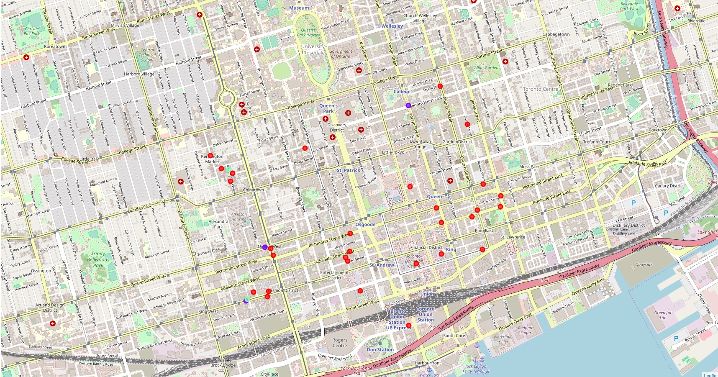
Clustered Result

Slide 9
Using the restaurant Canoe as an example showing the top 5: (First row is the original restaurant hence a distance of 0)
We can also sort by distance from your current geo location or rating etc.
 | index | Cluster Labels | id | name | categories | lat | lng | tipCount | priceTier | rating | distance
8 | 9 | 0 | 4ad4c05df964a52059f620e3 | Canoe | Restaurant | 43.647452 | -79.381320 | 74.0 | 3.0 | 9.1 | 0.000000
12 | 14 | 0 | 52138db911d22803b334c641 | Mos Mos Coffee | Caf\u00e9 | 43.648159 | -79.378745 | 11.0 | 1.0 | 8.8 | 0.222147
7 | 8 | 0 | 514627d1e4b0dba1b85e9ba8 | Dineen Coffee | Caf\u00e9 | 43.650497 | -79.378765 | 142.0 | 2.0 | 9.0 | 0.396161
5 | 5 | 0 | 506db1a9e4b0a3f3b31412f0 | Richmond Station | American Restaurant | 43.651569 | -79.379266 | 110.0 | 3.0 | 9.2 | 0.486478
15 | 18 | 0 | 4d5effa95b276dcbc3b201c6 | TOCA | Italian Restaurant | 43.645431 | -79.387059 | 10.0 | 4.0 | 8.7 | 0.514565
28 | 32 | 0 | 5346c98a498ed612110d0f60 | iQ Food Co | Salad Place | 43.642851 | -79.382081 | 15.0 | 1.0 | 8.9 | 0.514877

Slide 10
Limitation Faced with the free FourSquare account
The explore API only returned 100 venues
Information like visits count are also
Only 50 calls per day to get the details of a venue
To work around this limitation the intermediate result is stored in csv so the result can be used for the rest of the day

Slide 11
Potential Improvements
Some ideas of collecting more features include:
get an more accurate picture of how busy a restaruant is from the "visit counts" of the paid FourSquare account.
Use image recognization services to see what kinds of dishes people take photos of
Use natural language processing to see what dishes the restaurants offer in the menu posted
The data set size is also smaller due to the limitation of the FourSquare free account. It can be solved by using the paid account. The process would be exactly the same.

